Slide 1
Creating an Accessible
Scientific Poster
Kate Bucher
Metadata Librarian
NIST Research Library and Museum
Thursday, July 6, 2023

Slide 2
Agenda
Scientific posters and accessibility
Poster content
Design and layout
Images and alt text
Text, color, and fonts
Presenting your poster
Additional resources

Slide 3
Scientific posters and accessibility
Posters facilitate dissemination of research at all levels
Great way to gain experience
Consider accessibility during poster development
Take steps to ensure broadest audience possible can access
Minimize exclusion of participants
Notes:
Scientific posters and accessibility
SHIP students amongst you will be creating a scientific poster as part of your program here at NIST
Scientific posters facilitate dissemination of research at conferences to attendees of all:
experiences,
backgrounds,
interests,
career stages
Also a great way for students to gain experience presenting at conferences to prepare for college, graduate school, professional scientific careers
Accessibility of poster sessions is defined by the National Center for Biotechnology Information (NCBI) as: "Every community member has an equitable opportunity to obtain materials and participate regardless of income level, geographical location, ability status, or schedule availability."
There are no absolute guidelines for accessibility that guarantee equal access for everyone, but there are many steps you can take
to ensure the broadest audience possible is able to view your poster and access and engage with your research
and that participants are not excluded from that engagement as much as is possible
With that in mind, it's important to consider accessibility of your poster as you develop it, not at the end of the process

Slide 4
Poster content
Content before design and layout
Consider the poster's intended message
What information is needed to communicate that message?
If you had two minutes in an elevator to sell your research as a viable project, what would you say?
Notes:
First thing to consider is what your poster’s content is going to be, before you start planning your poster design
Consider the message you want to impart to your viewers
It's impossible to include every detail of your summer research. What information is needed to communicate that message?
What do you want your readers to be thinking about as they step away from your poster?
Think of it like an abstract or an elevator speech. If you had two minutes in an elevator to sell your research as a viable project, what would you say?

Slide 5
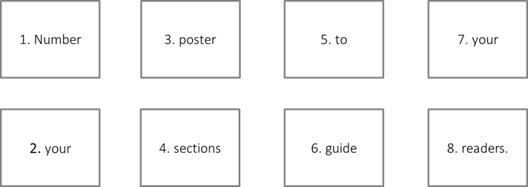
Design and layout
Notes:
conference will list poster size requirements, such as three feet or four feet
space designated for your poster at the conference will reflect that size.
be sure not to make your poster larger than that maximum size
Avoid overcrowding space with text and images
Use white space to separate sections of the poster
Many people use power-point-type slides as sections on a poster
Choose a way to guide the reader’s eye through the poster in a way that makes sense
For example, use letters or number them to take the viewer through the story of your poster

Slide 6
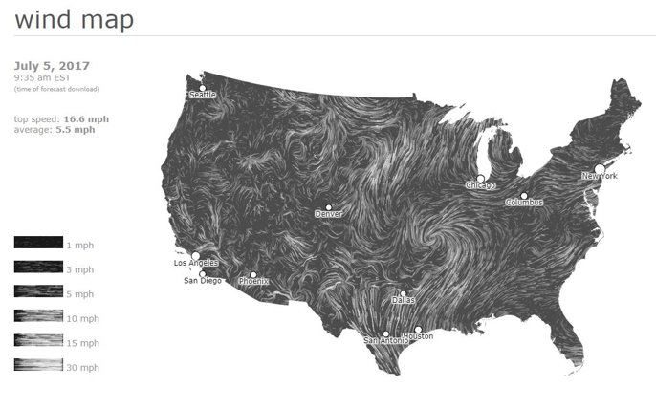
Images and alt text
Notes:
Providing information in multiple ways, not just text, but also images, graphs, and tables, makes the poster more accessible
Image resolution should be 300 dpi or higher
Be sure to caption or title the images
Ideally provide alt-text (a textual description of what the image shows or conveys) for all images and graphs, for the benefit of screen readers if you will be making your poster available electronically
Guideline for creating image descriptions and alt-text is provided in the Additional Resources slides of this presentation

Slide 7
Text, colors, and fonts
Use line spacing between 1.2 - 2.0
and a minimum of +3 letter spacing for all text if possible.
Use contrasting colors for font and background, such as:
Use Sans-serif fonts such as:
Arial
Gill Sans
Helvetica
Verdana
White text on dark blue background
Dark blue on white background
Black text on white background
Notes:
Text colors and background
Use contrasting colors such as white and dark blue or black for the poster's text and background colors to maximize readability.
You can ensure sufficient contrast between the text and the background using an online contrast checking tool.
See links in Additional Resources slides at the end of this presentation for example tools
Avoid relying solely on color to convey meaning.
Instead, use patterns or shading in addition to color on charts, graphs, illustrations, and maps where color differences are intended to convey information.
Utilize bold text, italics, and underlines to highlight information instead of different colors.
Fonts
For maximum accessibility Sans-serif fonts such as Arial, Gill Sans, Helvetica, and Verdana are recommended for body and heading text in your poster
Serif fonts such as Times New Roman and Garamond should only be used for headings, if at all
Line spacing:
For increased readability, use line spacing of 1.2 to 2.0 for your poster text.
If your word processing software allows, use letter spacing of a minimum of +3.
Letter spacing can be increased for title and section headings if you prefer.

Slide 8
Minimum and Ideal Poster Font Sizes
Text type | Minimum poster font | Ideal poster font
Main Title | 72 pt | 158 pt
Section Headings | 42 pt | 56 pt
Body Text | 24 pt | 36 pt
Captions | 18 pt | 24 pt
Notes:
(Note: PowerPoint's maximum font is 96 pt, shown here, so 158 pt is significantly larger.)
To maximize poster accessibility, the fonts for the different types of text on your poster should be, at minimum, the values shown here in the second column. Ideal font sizes are shown here in the third column.
This table is an example of the use of shading in place of color to communicate information. In this case, the lighter and darker gray shadings help to identify the subsequent lines of data in the table.
It's also important to consider line spacing and letter spacing.

Slide 9
Presenting your poster
In-person poster sessions at a conference
Virtual poster sessions
Additional materials for an accessible poster presentation
  Screen reader-friendly version of your poster
  Simplified, text-based alternative poster format
  Audio recording of text and visual aspects of your poster
Notes:
At a conference, you will be expected to present your poster at designated poster sessions, where you will stand with your poster and discuss its contents and your research with conference attendees.
Not everyone is able to attend a conference physically, and so many conferences now utilize openly accessible platforms for virtual poster sessions, such as:
Confex.com, Pathable.com, Vimeo.com, Youtube.com, Figshare.com, and others
Things you can do when preparing your poster presentation to maximize its accessibility at your conference:
Create a screen reader-friendly version of your poster as a PDF
Note: some resources will recommend you not create a PDF. If you do so, you must ensure it is an accessibly, 508-compliant PDF document. Adobe Acrobat has wizards that can help you with this, but it does take some work. See the Additional Resources slide for a helpful link with guidance on how to do this.
Prepare additional formats of your poster to provide to conference attendees.
Create a simplified .doc, .pdf, or webpage version of your poster that does not include graphics. This will be a text-based alternative to your poster.
If you choose to use PDF you will need to confirm it is also screen reader-friendly
If using .doc or .pdf, you might upload this alternate format to your cloud storage system
You can link to your alternatative poster format via a TinyURL, Bit.ly, or QR code located on your poster
Create an audio recording of the text and visual materials on your poster
You can also link to this audio recording using a QR code or TinyURL on your poster

Slide 10
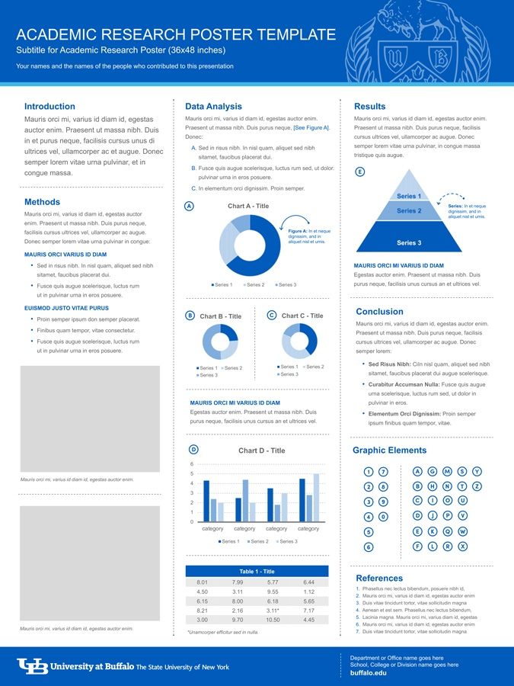
Notes:
Sample Poster- SUNY Buffalo’s academic research poster template- note the captions, the use of blue and black text on white, and how shading and bold text are used to convey and highlight information.

Slide 11
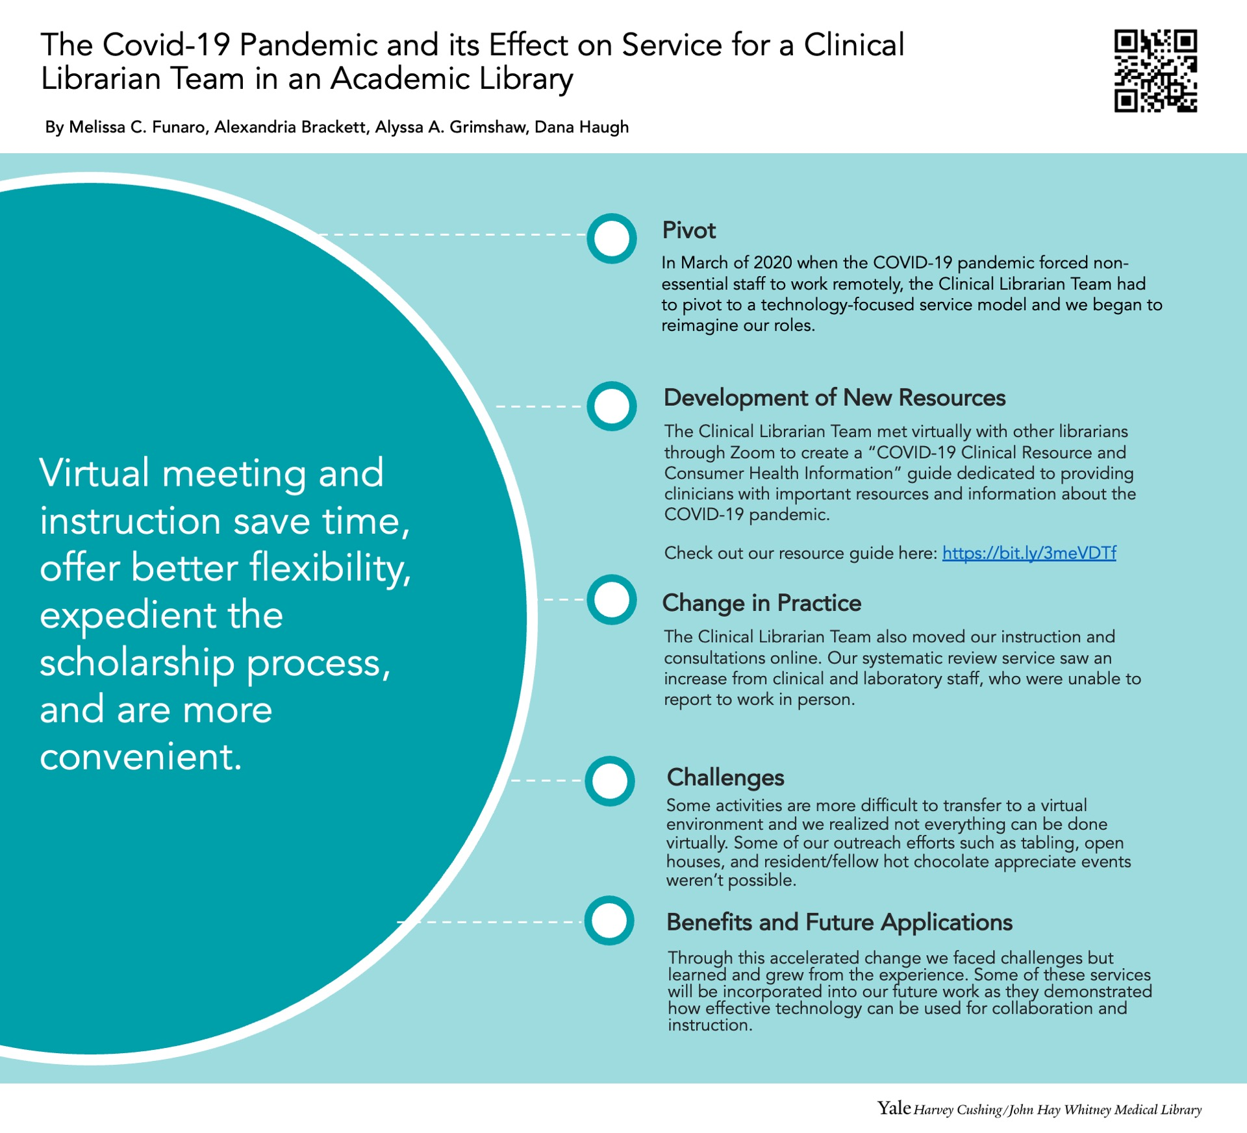
Notes:
Another example, this one from Yale- again, the use of Sans serif fonts, the QR code, the use of the shades of teal to designate different sections of the text. How the design guides the eye through the poster.

Slide 12
Additional resources
Colour Contrast Analyser (CCA): https://www.tpgi.com/color-contrast-checker/
WebAIM Contrast Checker: https://webaim.org/resources/contrastchecker/
Guidelines for Creating Image Descriptions: https://americananthro.org/accessibility/image-descriptions/
How to Create and Confirm an Accessible PDF Document: https://americananthro.org/accessibility/pdf-document-tips/
Notes:
Don't forget the many NIST scientific posters on display in the labs on campus! Note that many are from previous years and may not showcase features that maximize accessibility, but many are good sources of inspiration for content and design.

Slide 13
Association of University Centers on Disabilities: https://www.aucd.org/docs/annual_mtg_2008/accessibility_posters_gilson2007.pdf
University of Washington: https://www.washington.edu/doit/how-can-i-create-conference-poster-accessible-people-disabilities
Yale Library: https://guides.library.yale.edu/academic-poster-resources/accessibility
American Anthropological Association: https://americananthro.org/accessibility/poster-gallery-session-guidelines/#poster-formatting
National Center for Biotechnology Information: https://www.ncbi.nlm.nih.gov/pmc/articles/PMC9053039/

Slide 14
Questions?

